Slide 1
Spline Interpolation

Slide 2
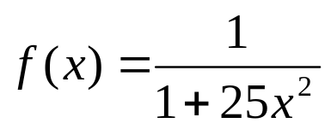
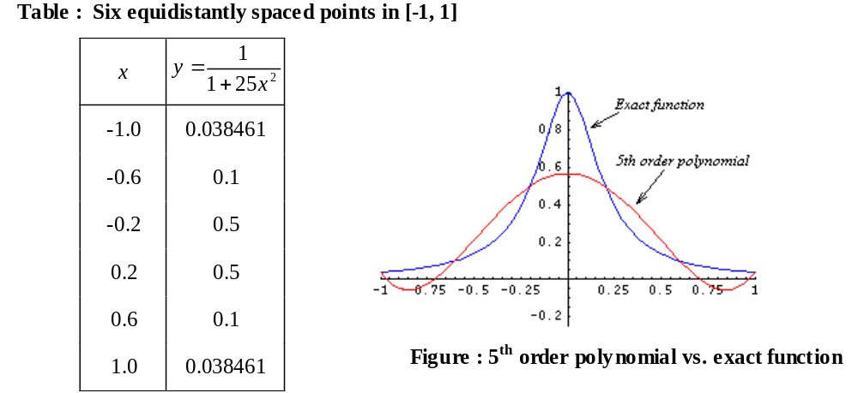
Why Spline?

Slide 3
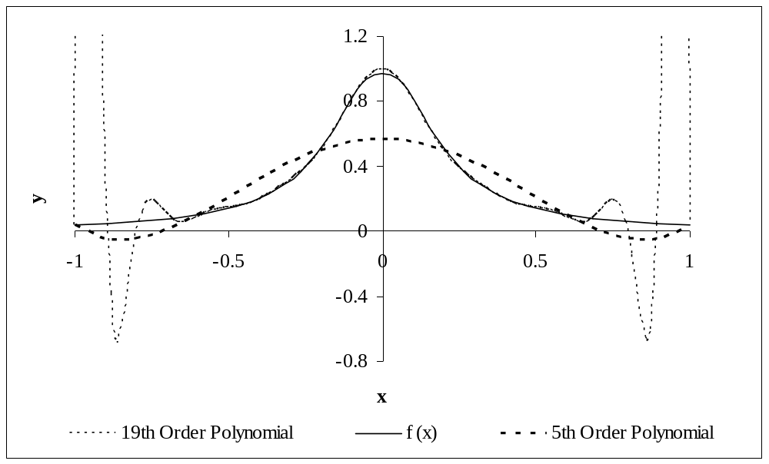
Why Spline?
Figure : Higher order polynomial interpolation is a bad idea

Slide 4


Spline Interpolation
Spline: Special type of piecewise interpolant polynomial
x1
x2
x3
x4
x5
x6
x7
x8

Slide 5
Spline Interpolation
Given interval [a, b] divided by (n-1) subintervals such as a = x₁ < x₂ < …< x_{n} = b, k-th order spline function s(x) should satisfy the following conditions
  Condition 1 : s(x) should be represented with at most k-th order polymomial in [x_{i}, x_{i+1}] for i = 1, 2,…, n
  Condition 2 : Derivatives s(x), s'(x), s'' (x), …, and s^{k-1}(x) should be continuous in [a, b]

Slide 6
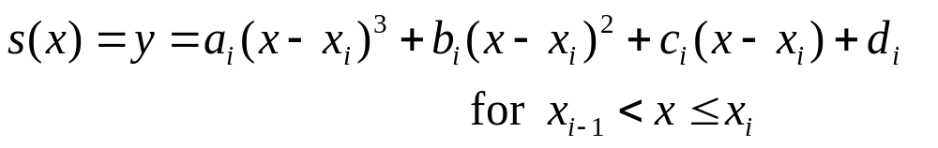
Spline Interpolation
3-rd order spline in [x_{i}, x_{i+1}] :
  the smallest order polynomial that satisfies the two conditions
  3-rd order polynomial in i-th subinterval given two points (x_{i}, y_{i}) and (x_{i+1}, y_{i+1})

Slide 7
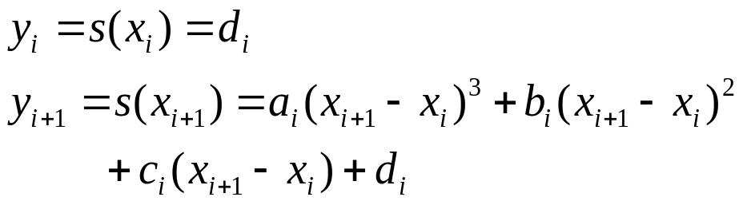
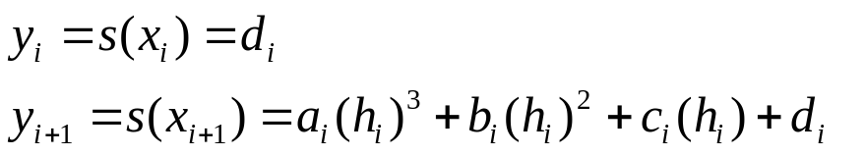
Spline Interpolation
The spline must pass two ending points (x_{i}, y_{i}) and (x_{i+1}, y_{i+1}) of the subinterval
Let h_{i} = x_{i+1} – x_{i} .
(1)

Slide 8
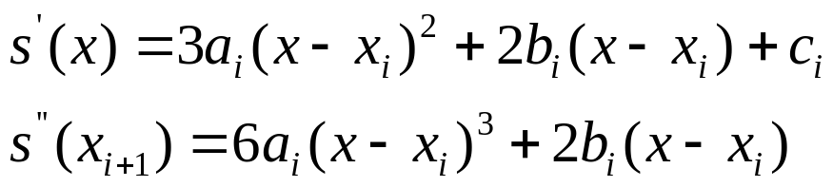

Spline Interpolation
Taking the first and second derivatives,
Let s_{i} and s_{i+1} be the second derivatives at (x_{i}, y_{i}) and (x_{i+1}, y_{i+1}), respectively.

Slide 9
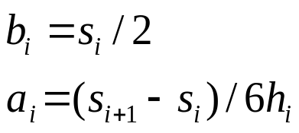
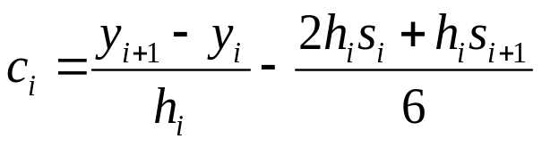
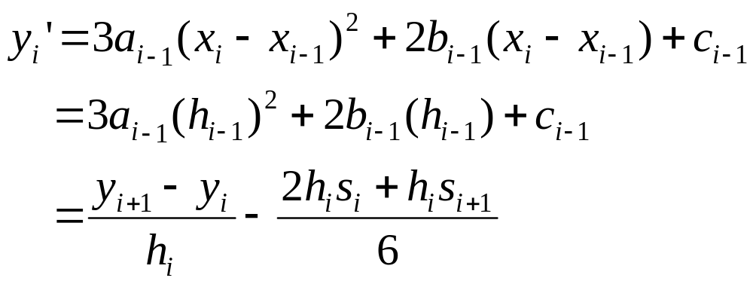
Spline Interpolation
Then
By replacing eq. (1) by the a_{i} and b_{i}
Because y_{i}’=s’(x_{i})=c_{i}, and it should be equal to the derivative from the previous spline polynomial,

Slide 10
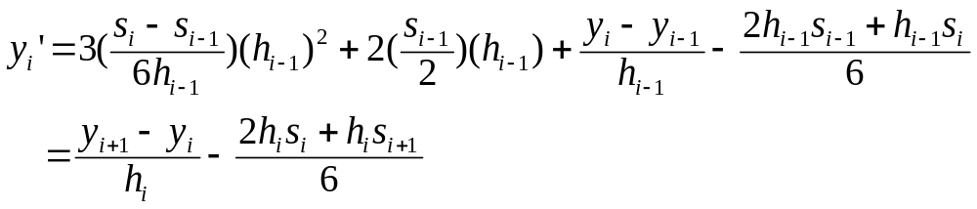
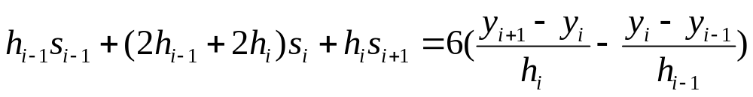
Spline Interpolation
Summarizing the equation,

Slide 11
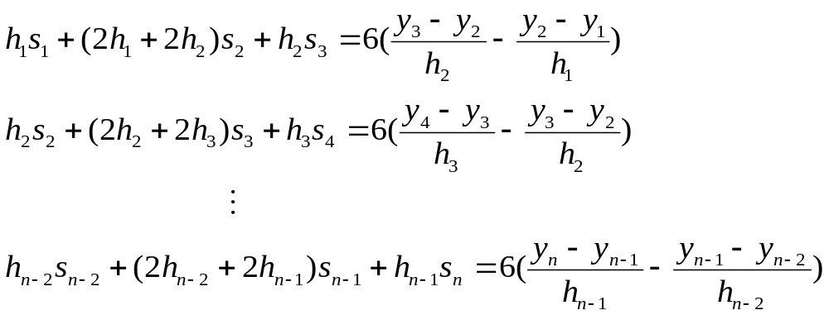
Spline Interpolation
Substituting all intermediate points for i=2,…,n-1,

Slide 12
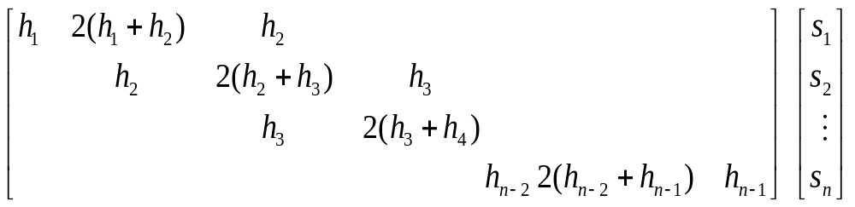
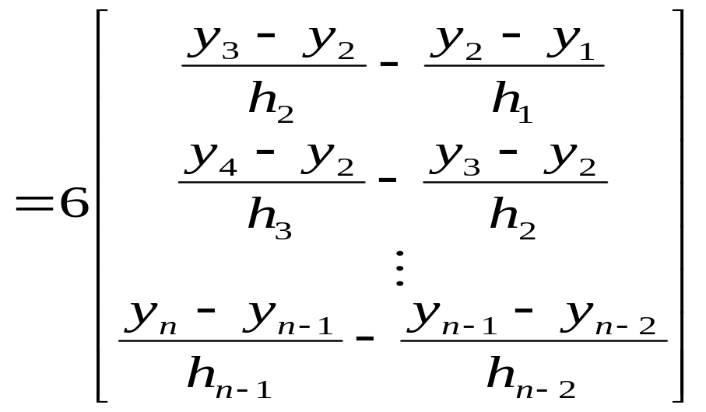
Spline Interpolation
Matrix representation

Slide 13
Spline Interpolation
Need more equations
  Number of equations = n – 2
  Number of the second derivatives s_{i}
(i =1,2,…n)
Three ways to select s₁, and s_{n}
  s₁ = s_{n} = 0
  s₁ = s₂ , s_{n} = s_{n-1}
  s₁=extrapolation(s₂, s₃ ) s_{n}= extrapolation(s_{n-1} ,s_{n-2})

Slide 14
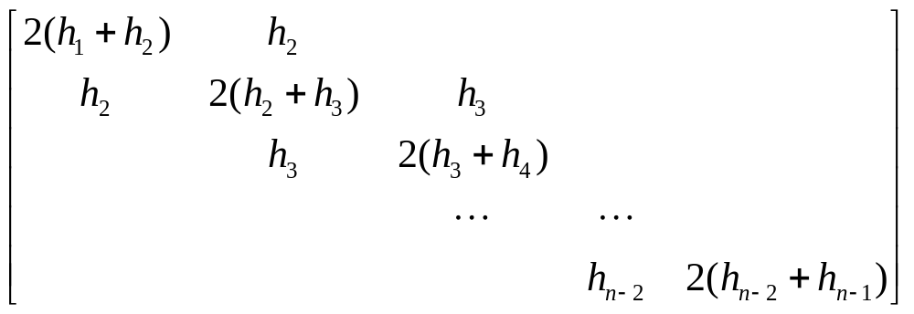
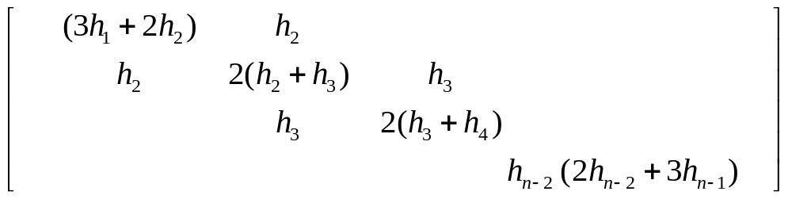
Spline Interpolation
  Method 1 : s₁ = s_{n} = 0. For i = 2, …, n-1
  Method 2 : s₁ = s₂ , s_{n} = s_{n-1} . For i = 2, …, n-1

Slide 15
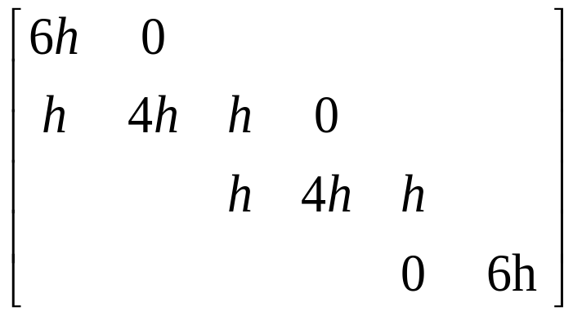
Spline Interpolation
  Method 3 : When h_{i} are equal for all i. s₁ = 2s₂-s₃, s_{n} = 2s_{n-1}- s_{n-2}. For i = 2, …, n-1

Slide 16
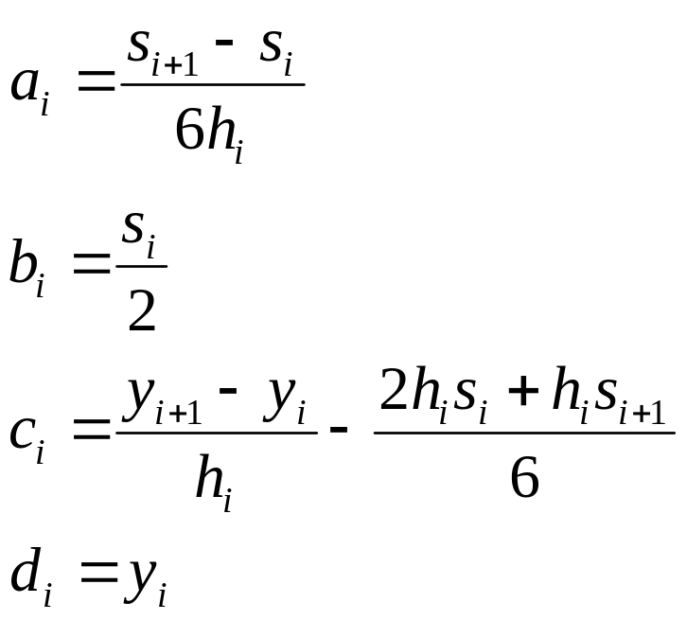
Spline Interploation
After solving the linear equations for s_{i} (i =1,2,…n)

Slide 17
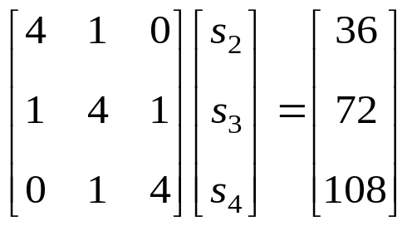
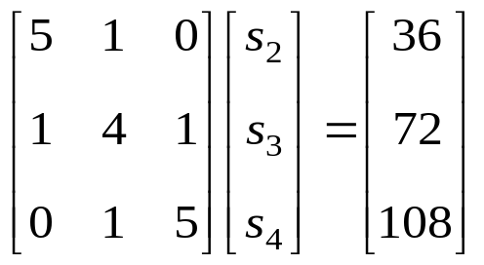
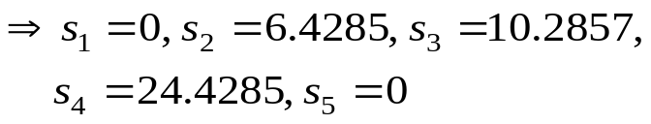
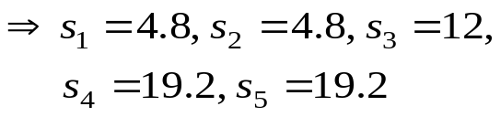
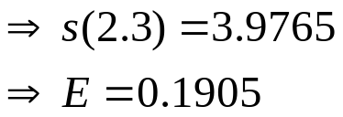
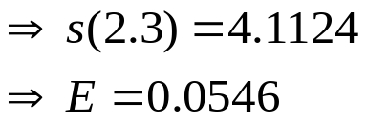
Example
x = 2.3
x | 0 | 1 | 2 | 3 | 4
y | -8 | -7 | 0 | 19 | 56
Method1: s₁ = s_{n} = 0
Method 2 : s₁ = s₂ , s_{n} = s_{n-1}

Slide 18
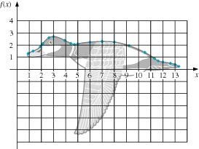

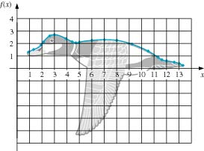
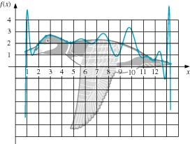
Example
21points for contour approximation
Lagrange Method

